Slide 1
MATLAB
An Introduction

Slide 2
Matlab
one of many computing platforms we could use in this course.
Others:
Excel (with VBA)
Mathematica
MathCad
Maple
Handheld Calculator

Slide 3
Matlab Advantages
Easily handles arrays
Efficient calculator
Good graphics
Built in structured programming language

Slide 4
Matlab Disadvantages
Expensive
Large and slow to load
Command driven – not intuitive
Not readily available

Slide 5
Use It
To Open
Double click icon or an existing Matlab file
Has three interface windows or GUI’s
Command Window – opens first by default
Graphics Window
Edit Window

Slide 6
Command Window
Has four panes by default
Command
Command History
File Directory
Workspace

Slide 7
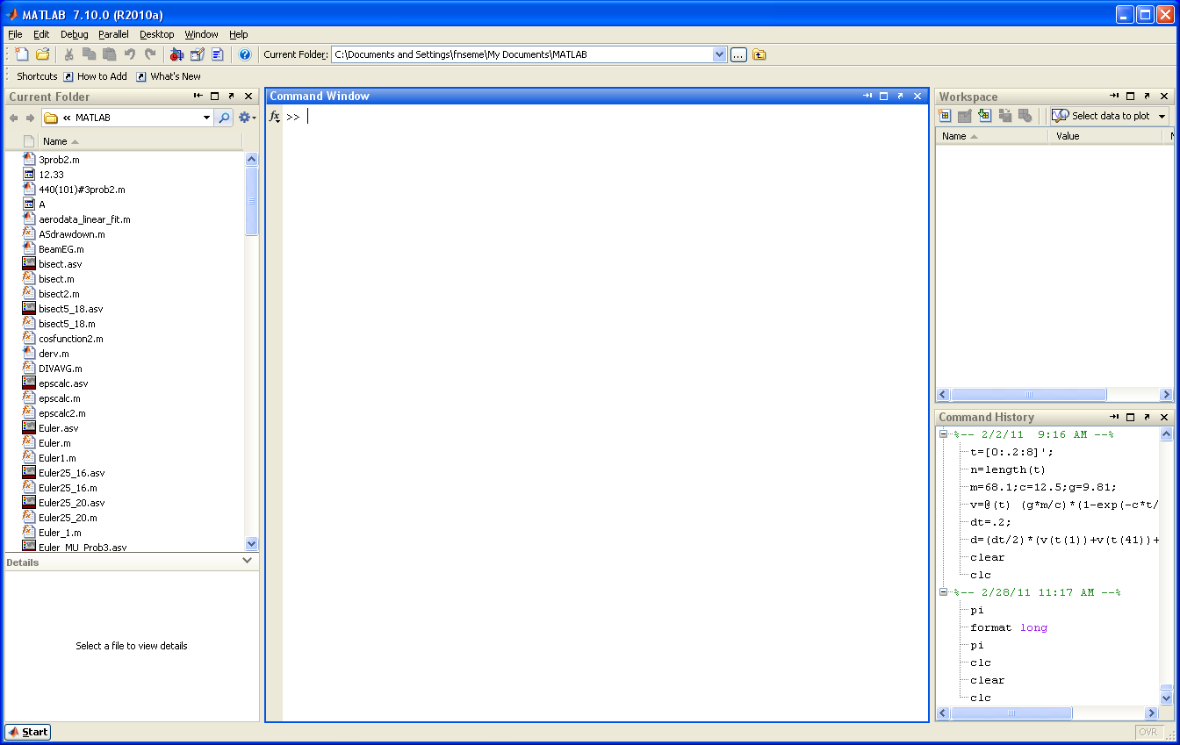
File Directory
Command Window
Workspace
Command History

Slide 8
Command Window
Enter commands in the Command Window
Can use as a simple calculator
Without an assignment, results assigned to variable ”ans” by default
Can instead assign values to variables
Use Assignment command “ =“
NOTE: Names are case-sensitive
Matlab creates proper type and saves to memory
Puts the variable and its value into the workspace
Results are automatically echoed – can shut off with ; at end of the command line

Slide 9
Format Command
Controls how numbers are displayed – does not affect the value stored or the calculation precision
>> format ‘type’
Possible types
short (default) – four decimals displayed
long – fifteen decimals displayed
short e – exponential with four decimals
long e – exponential with fifteen decimals
short eng – engineering with four decimals
long eng – engineering with fifteen decimals

Slide 10
Arrays
Array – an organized collection or set of numbers
Vector – one dimensional array – either a row or a column
Matrix – two dimensional array
to enter
use “ [ “ followed by elements and closed by “ ] “
separate elements by a space
separate rows by a ; or return

Slide 11
Colon “ : “ Operator
Can be used as a wild card or short cut in creating arrays
Try it with: x = 5:2:21 or x=-10:5

Slide 12
Math Operations
Matlab uses the standard operators
+
-
*
/
^
Note: Matlab automatically uses matrix operations by default. If a variable is an array you must have proper dimensions or you get an error
Element by element operations done only if an operator is preceded by a “ . “

Slide 13
Built-In Functions
wide array of math functions are built-in
typical notation – sqrt( ), cos( ), abs( ), and many more
Help and definitions
help > Function Browser (shift + F1)
gives definitions, help and examples

Slide 14
Some Useful Functions
zeros(n) – creates n x n matrix of zeros
zeros(n,m) – creates n x m matrix of zeros
ones(n) or ones(n,m) – same for matrices of all ones
eye(n) – creates n x n identity matrix
linspace(x1, x2, n) – creates linear array of n elements starting with x1 and ending with x2
If n is omitted – default is 100 elements

Slide 15
Graphics
basic plotting command
plot(x,y) – creates graph of y(x)
x = vector of x values
y = vector of corresponding y values
both must be of same dimension
formatting graphs
grid or grid minor
xlabel(‘ text ‘), ylabel(‘ text ‘)
title(‘ text’)

Slide 16


Try It – Free-Falling Object
F_{d} = c v²
$${dv}/{dt}=g − \frac{c}{m} v^{2}$$
mg
Evaluate the solution (in m/s) given by:
$v\left(t\right)= \sqrt{\frac{m g}{c}} tanh⁡(\sqrt{\frac{g c}{m}}t)$
For t = 12 seconds
Use
m=68.1 kg
g = 9.81 m/s^2
c = 0.25 kg/s
Then evaluate v(t) for t = 0 to 25 seconds
Plot v(t), label axis and add title
Do in MSWord, put in header and footer, convert to pdf, and submit to practice dropbox.

